Slide 1
CIS 470 Mobile App Development
Lecture 15
Wenbing Zhao
Department of Electrical Engineering and Computer Science
Cleveland State University

Slide 2
Services
How to create a service that runs in the background
How to perform long-running tasks in a separate thread
How to perform repeated tasks in a service
How an activity and a service communicate

Slide 3
What is a Service
A facility for the application to tell the system about something it wants to be doing in the background
Even when the user is not directly interacting with the application
This corresponds to calls to Context.startService(), which ask the system to schedule work for the service, to be run until the service or someone else explicitly stop it
A facility for an application to expose some of its functionality to other applications
This corresponds to calls to Context.bindService(), which allows a long-standing connection to be made to the service in order to interact with it

Slide 4
What is a Service
A Service is not a separate process. The Service object itself does not imply it is running in its own process; unless otherwise specified, it runs in the same process as the application it is part of
A Service is not a thread. It is not a means itself to do work off of the main thread

Slide 5
Service Lifecycle
If someone calls Context.startService() then the system will retrieve the service and then call its onStartCommand(Intent, int, int) method with the arguments supplied by the client
The service will at this point continue running until Context.stopService() or stopSelf() is called
There are two major modes of operation depending on the value they return from onStartCommand():
START_STICKY is used for services that are explicitly started and stopped as needed
START_NOT_STICKY or START_REDELIVER_INTENT are used for services that should only remain running while processing any commands sent to them

Slide 6
Service Permission
Global access to a service can be enforced when it is declared in its manifest's <service> tag
By doing so, other applications will need to declare a corresponding <uses-permission> element in their own manifest to be able to start, stop, or bind to the service

Slide 7
Basic Service
Basic steps of creating/using a service:
Create a separate service java class
Add service in the manifest
Start/stop the service from the main activity
Create a new project and name it Services
Modify manifest:
<?xml version="1.0" encoding="utf-8"?> <manifest xmlns:android=http://schemas.android.com/apk/res/android package="com.wenbing.services"> <application android:allowBackup="true" android:icon="@mipmap/ic_launcher" android:label="@string/app_name" android:roundIcon="@mipmap/ic_launcher_round" android:supportsRtl="true" android:theme="@style/AppTheme"> <activity android:name=".MainActivity"> <intent-filter> <action android:name="android.intent.action.MAIN" /> <category android:name="android.intent.category.LAUNCHER" /> </intent-filter> </activity> <service android:name=".MyService" /> </application> </manifest>

Slide 8
Basic Service
import android.app.Service; import android.content.Intent; import android.os.IBinder; import android.widget.Toast; import java.net.MalformedURLException; import java.net.URL; import android.os.AsyncTask; import android.util.Log; import java.util.Timer; import java.util.TimerTask;
Add a new Java class: MyService
public class MyService extends Service { int counter = 0; static final int UPDATE_INTERVAL = 1000; private Timer timer = new Timer(); @Override public IBinder onBind(Intent arg0) { return null; } @Override public int onStartCommand(Intent intent, int flags, int startId) { Toast.makeText(this, "Service Started", Toast.LENGTH_LONG).show(); doSomethingRepeatedly(); try { new DoBackgroundTask().execute( new URL("http://www.amazon.com/somefiles.pdf"), new URL("http://www.wrox.com/somefiles.pdf"), new URL("http://www.google.com/somefiles.pdf"), new URL("http://www.learn2develop.net/somefiles.pdf")); } catch (MalformedURLException e) { e.printStackTrace(); } return START_STICKY; }
Perform task asynchronously: don’t wait for completion

Slide 9
@Override public void onDestroy() { super.onDestroy(); if (timer != null){ timer.cancel(); } Toast.makeText(this, "Service Destroyed", Toast.LENGTH_LONG).show(); } private void doSomethingRepeatedly() { timer.scheduleAtFixedRate(new TimerTask() { public void run() { Log.d("MyService", String.valueOf(++counter)); } }, 0, UPDATE_INTERVAL); } private class DoBackgroundTask extends AsyncTask<URL, Integer, Long> { protected Long doInBackground(URL... urls) { int count = urls.length; long totalBytesDownloaded = 0; for (int i = 0; i < count; i++) { totalBytesDownloaded += DownloadFile(urls[i]); publishProgress((int) (((i + 1) / (float) count) * 100)); } return totalBytesDownloaded; }
Calculate percentage downloaded and report its progress

Slide 10
onProgressUpdate is invoked when you call publishProgress()
protected void onProgressUpdate(Integer... progress) { Log.d("Downloading files", String.valueOf(progress[0]) + "% downloaded"); Toast.makeText(getBaseContext(), String.valueOf(progress[0]) + "% downloaded-"+counter, Toast.LENGTH_LONG).show(); } protected void onPostExecute(Long result) { Toast.makeText(getBaseContext(), "Downloaded " + result + " bytes", Toast.LENGTH_LONG).show(); //stopSelf(); } } private int DownloadFile(URL url) { try { //---simulate taking some time to download a file--- Thread.sleep(5000); } catch (InterruptedException e) { e.printStackTrace(); } //---return an arbitrary number representing // the size of the file downloaded--- return 100; } }
The onPostExecute() is invoked in the UI thread and is called when the doInBackground() method has finished execution
Call stopSelf() if you want to destroy the service as soon as the long-running task is done

Slide 11
Basic Service
<?xml version="1.0" encoding="utf-8"?> <androidx.constraintlayout.widget.ConstraintLayout xmlns:android="http://schemas.android.com/apk/res/android" xmlns:app="http://schemas.android.com/apk/res-auto" xmlns:tools="http://schemas.android.com/tools" android:id="@+id/activity_main" android:layout_width="match_parent" android:layout_height="match_parent" tools:context=".MainActivity"> <Button android:text="Start Service" android:layout_width="90dp" android:layout_height="50dp" android:id="@+id/btnStartService" app:layout_constraintLeft_toLeftOf="@+id/activity_main" app:layout_constraintTop_toTopOf="@+id/activity_main" android:layout_marginTop="16dp" app:layout_constraintRight_toRightOf="@+id/activity_main" app:layout_constraintBottom_toTopOf="@+id/btnStopService" android:layout_marginBottom="8dp" android:onClick="startService" /> <Button android:text="Stop Service" android:layout_width="88dp" android:layout_height="48dp" android:id="@+id/btnStopService" app:layout_constraintLeft_toLeftOf="@+id/activity_main" android:layout_marginStart="16dp" app:layout_constraintTop_toTopOf="@+id/activity_main" app:layout_constraintRight_toRightOf="@+id/activity_main" android:layout_marginEnd="16dp" app:layout_constraintBottom_toBottomOf="@+id/activity_main" android:onClick="stopService" /> </androidx.constraintlayout.widget.ConstraintLayout>
Modify layout: add two buttons to start/stop service

Slide 12
Basic Service
Modify MainActivity.java: start/stop service
import androidx.appcompat.app.AppCompatActivity;
import android.os.Bundle; import android.content.Intent; import android.view.View; public class MainActivity extends AppCompatActivity { @Override protected void onCreate(Bundle savedInstanceState) { super.onCreate(savedInstanceState); setContentView(R.layout.activity_main); } public void startService(View view) { startService(new Intent(getBaseContext(), MyService.class)); } public void stopService(View view) { stopService(new Intent(getBaseContext(), MyService.class)); } }

Slide 13
Communication between Service and Activity
Create another app and name it MyService2
Add a Java class MyIntentService
Add the service in manifest
<?xml version="1.0" encoding="utf-8"?> <manifest xmlns:android="http://schemas.android.com/apk/res/android" package="com.....myservices2"> <application android:allowBackup="true" android:icon="@mipmap/ic_launcher" android:label="@string/app_name" android:roundIcon="@mipmap/ic_launcher_round" android:supportsRtl="true" android:theme="@style/AppTheme"> <activity android:name=".MainActivity"> <intent-filter> <action android:name="android.intent.action.MAIN" /> <category android:name="android.intent.category.LAUNCHER" /> </intent-filter> </activity> <service android:name=".MyIntentService" /> </application> </manifest>

Slide 14
Communication between Service and Activity
import android.app.IntentService; import android.content.Intent; import android.util.Log; import java.net.MalformedURLException; import java.net.URL; public class MyIntentService extends IntentService { public MyIntentService() { super("MyIntentServiceName"); } @Override protected void onHandleIntent(Intent intent) { try { int result = DownloadFile(new URL("http://www.amazon.com/somefile.pdf")); Log.d("IntentService", "Downloaded " + result + " bytes"); Intent broadcastIntent = new Intent(); broadcastIntent.setAction("FILE_DOWNLOADED_ACTION"); getBaseContext().sendBroadcast(broadcastIntent); } catch (MalformedURLException e) { e.printStackTrace(); } } private int DownloadFile(URL url) { try { Thread.sleep(5000); } catch (InterruptedException e) { e.printStackTrace(); } return 100; } }
Populate MyIntentService.java
//---send a broadcast to inform the activity // that the file has been downloaded---

Slide 15
Communication between Service and Activity
import androidx.appcompat.app.AppCompatActivity;
import android.os.Bundle; import android.content.BroadcastReceiver; import android.content.Context; import android.content.Intent; import android.content.IntentFilter; import android.view.View; import android.widget.Toast; public class MainActivity extends AppCompatActivity { IntentFilter intentFilter; @Override protected void onCreate(Bundle savedInstanceState) { super.onCreate(savedInstanceState); setContentView(R.layout.activity_main); } @Override public void onResume() { super.onResume(); intentFilter = new IntentFilter(); intentFilter.addAction("FILE_DOWNLOADED_ACTION"); //---register the receiver--- registerReceiver(intentReceiver, intentFilter); } @Override public void onPause() { super.onPause(); //---unregister the receiver--- unregisterReceiver(intentReceiver); }
Modify MainActivity.java
intent to filter for file downloaded intent

Slide 16
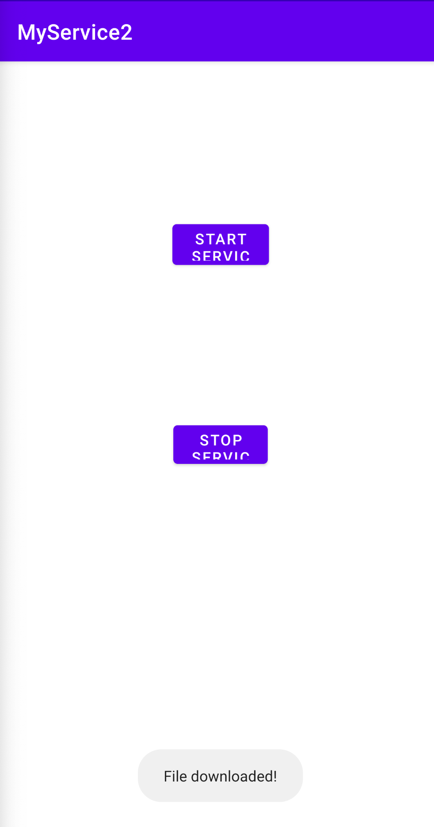
Communication between Service and Activity
Modify MainActivity.java
Modify the layout to add two buttons as before
public void startService(View view) { startService(new Intent(getBaseContext(), MyIntentService.class)); } public void stopService(View view) { stopService(new Intent(getBaseContext(), MyIntentService.class)); } private BroadcastReceiver intentReceiver = new BroadcastReceiver() { @Override public void onReceive(Context context, Intent intent) { Toast.makeText(getBaseContext(), "File downloaded!", Toast.LENGTH_LONG).show(); } }; }

Slide 17
Communication between Service and Activity
You can put data into the intent as a way to communicate specific data between the main activity and the service
// Creates a new Intent to start a service. Passes a URI in the Intent's "data" field. mServiceIntent = new Intent(); mServiceIntent.putExtra("download_url", dataUrl));
// Creates a new Intent containing a Uri object BROADCAST_ACTION is a custom Intent action Intent localIntent = new Intent(Constants.BROADCAST_ACTION) // Puts the status into the Intent .putExtra(Constants.EXTENDED_DATA_STATUS, status); // Broadcasts the Intent to receivers in this app. LocalBroadcastManager.getInstance(this).sendBroadcast(localIntent);

Slide 18
Homework#18
Modify the Services app:
Use a ProgressBar view instead/in addition to the Toast to display the progress made by the service

